Slide 1
Modernist Library
Data Science for Design
Xudong Jiang, Shiyun Yu, Yi He

Slide 2
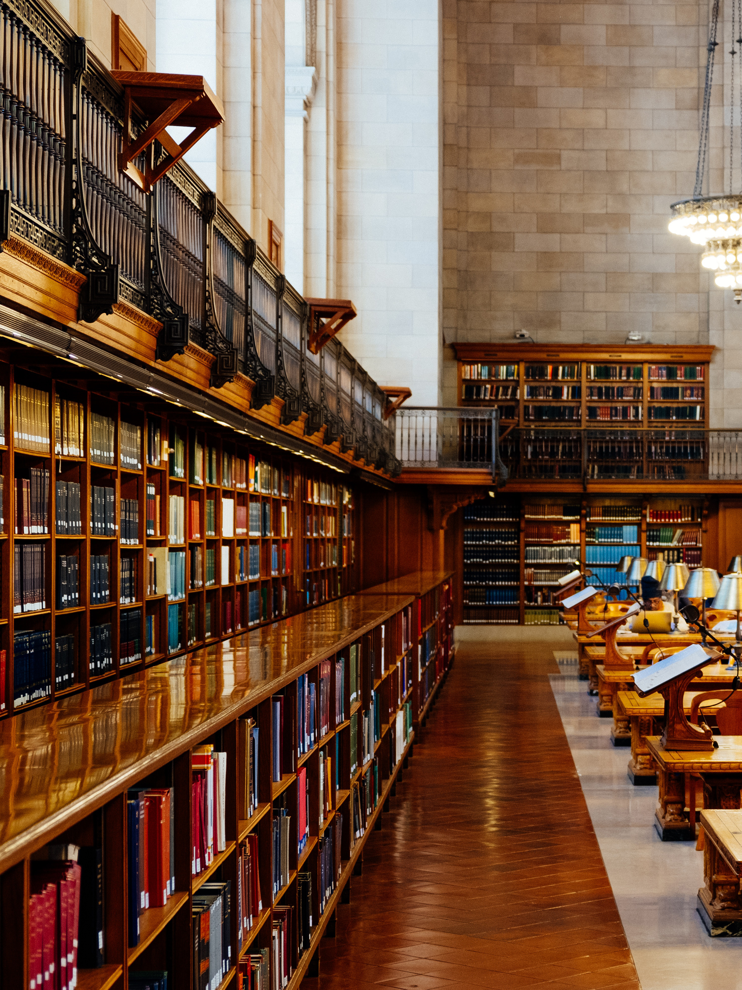
Context
Online modernist library
Gather books from various sources
Abundant poem resource
Catalog and borrow books

Slide 3
Data
Books in the library
Book Owner
13 Owners
23320 books in total
Book
Title
128 Poems
BookID
WorkID
17 Ulysses 15 Poems 13 Selected poems
Publication
Date
1880-1950

Slide 4
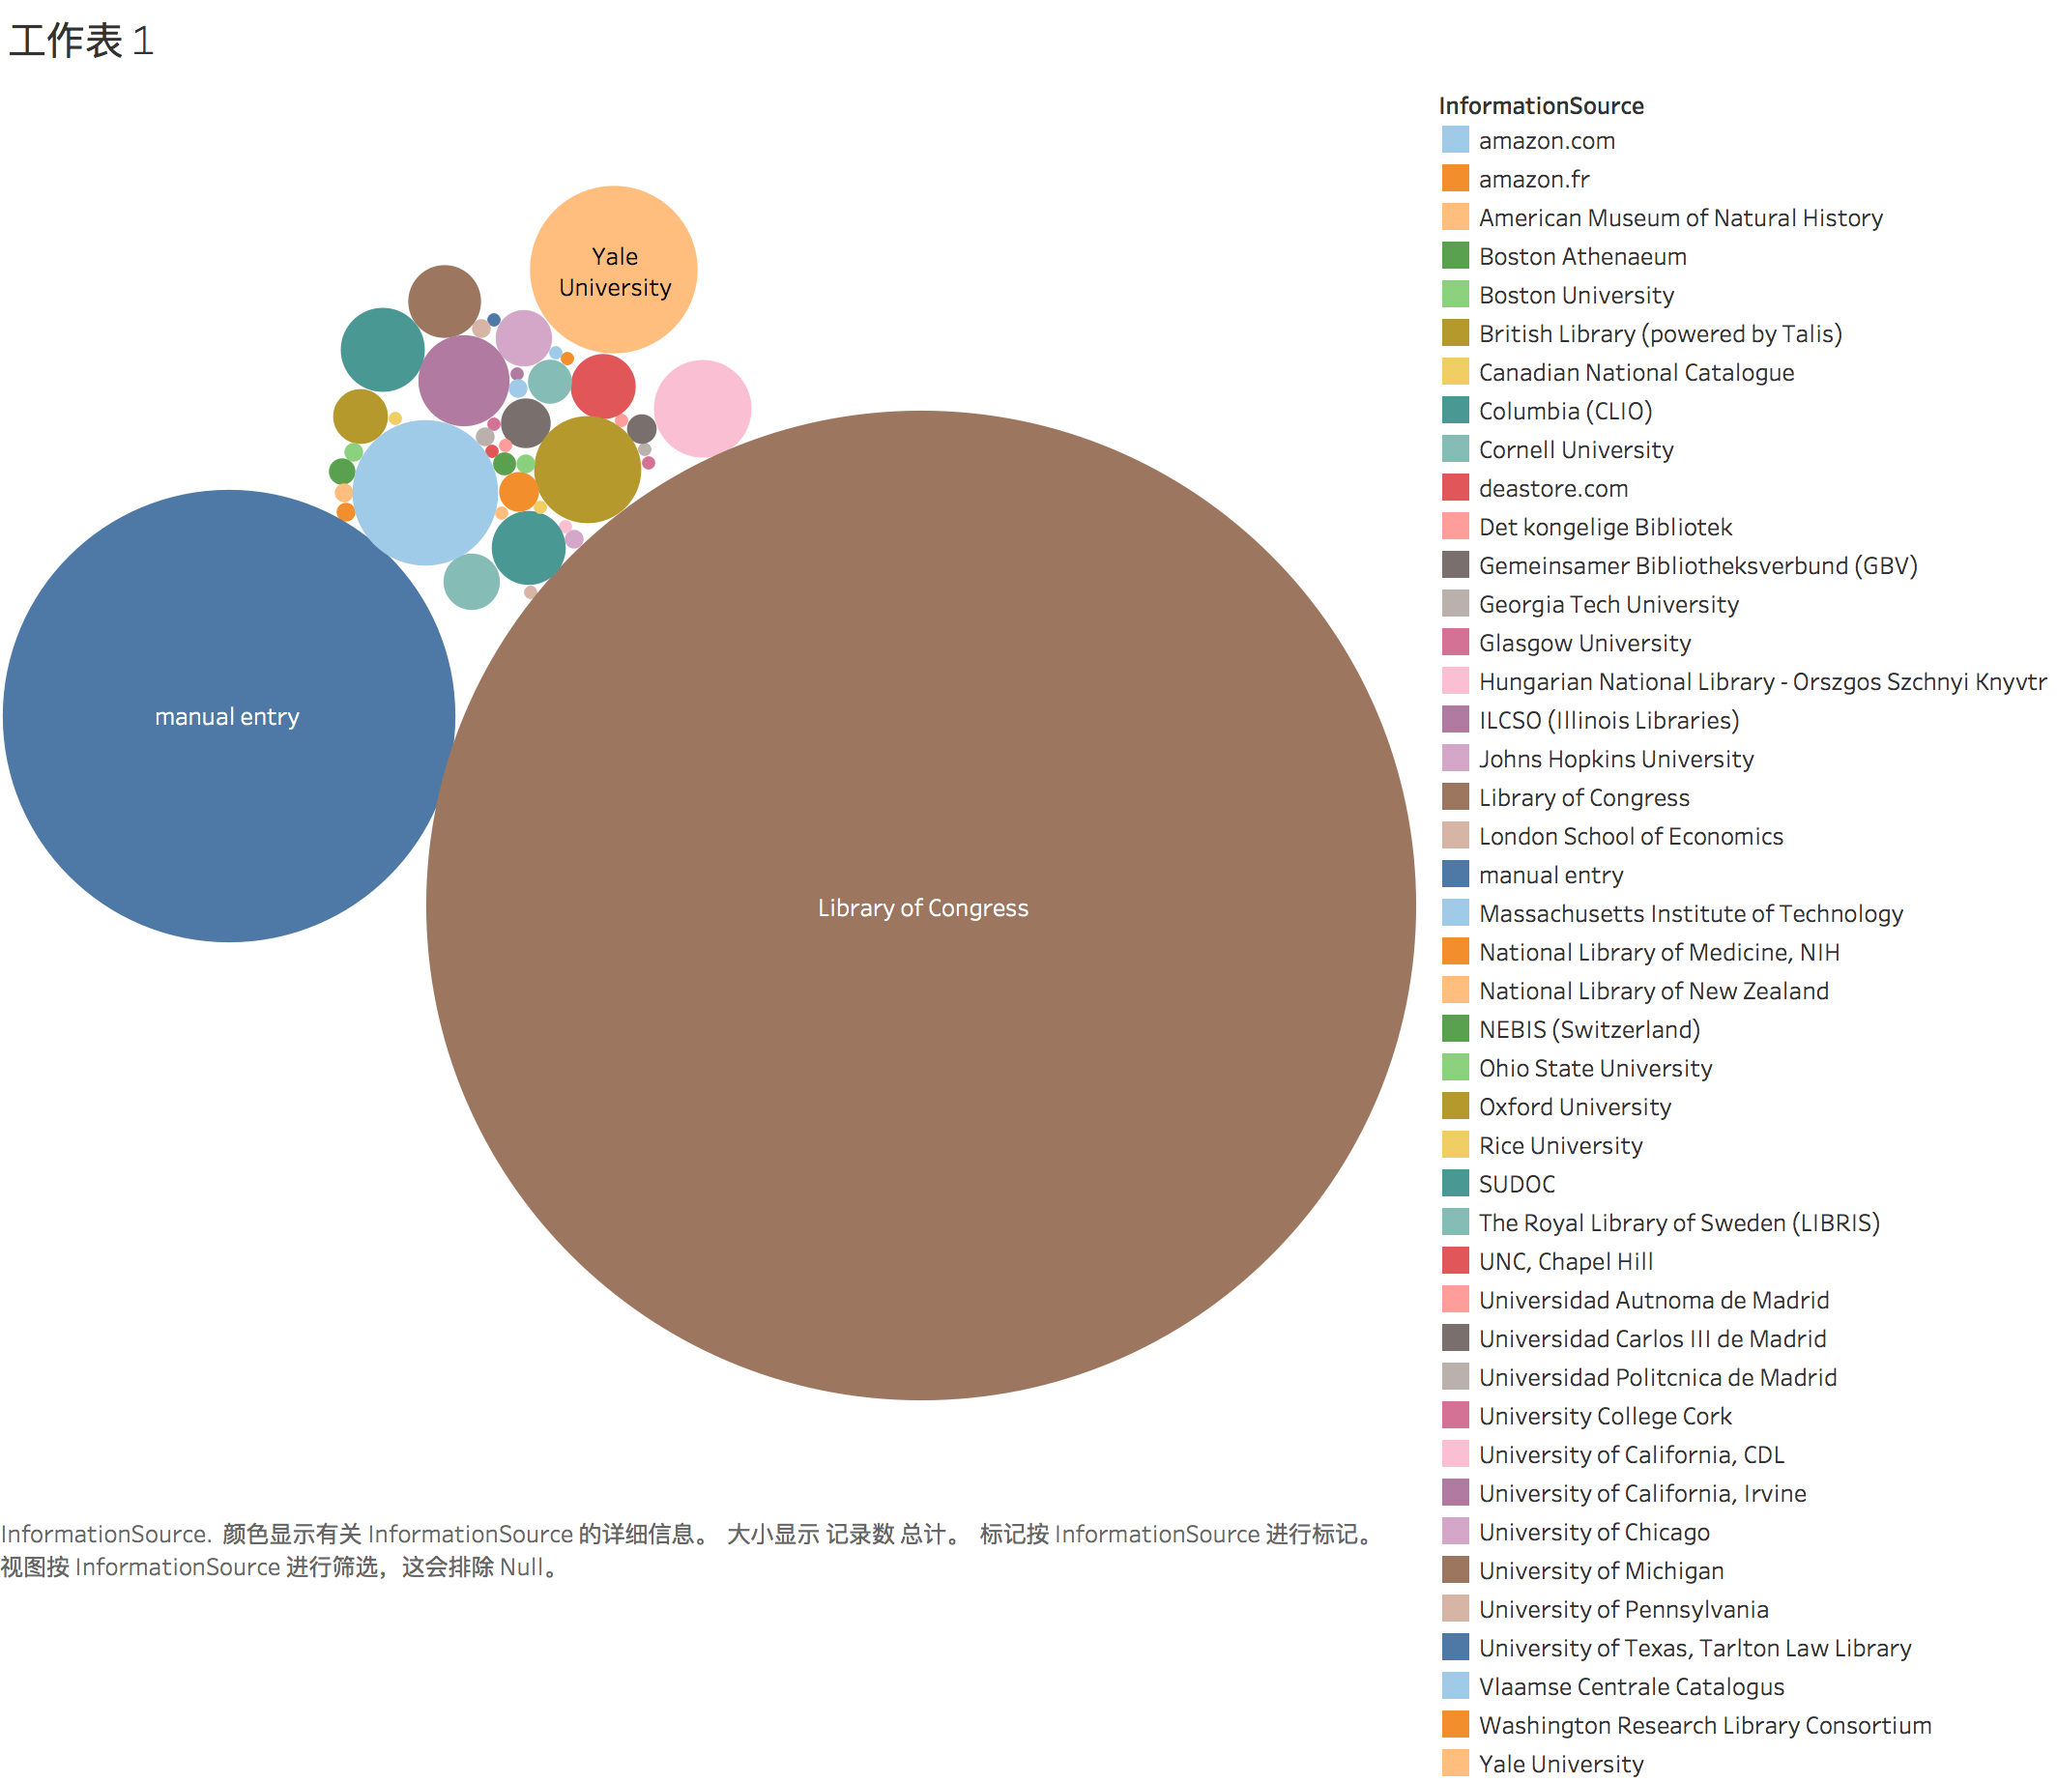
Data
Books in the library

Slide 5

Audience
Readers, especially those who are crazy about poems.
Various resources of poems in our library
Different versions of the same book

Slide 6
Demo

Slide 7
https://www.youtube.com/watch?v=DtgEPZ4KEFk

Slide 8


Question Time

Slide 9
Thank You
Data Science for Design
Xudong Jiang, Shiyun Yu, Yi He

